Slide 1

Azure
Developer CLI

Slide 2
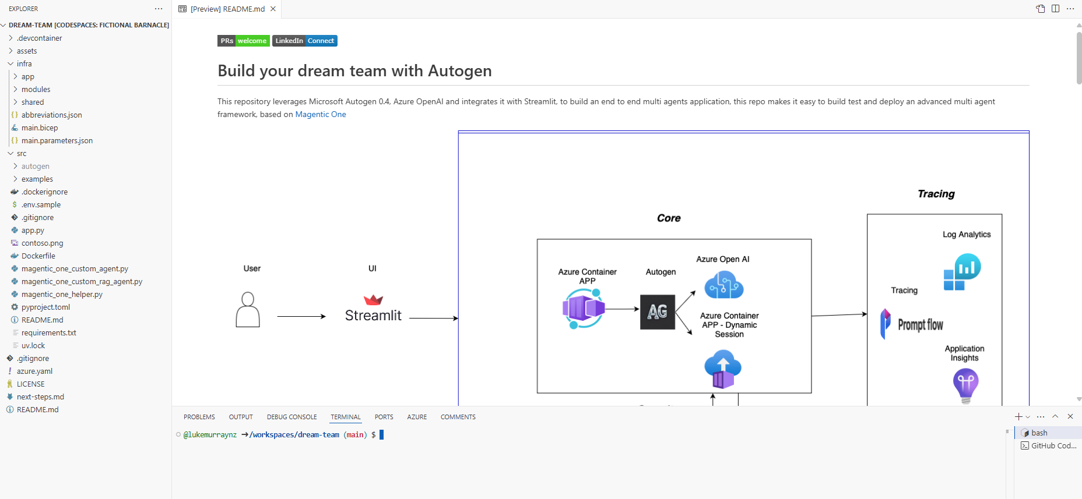
AZD
Folder/File | Note
Infra | An infra folder that holds the infrastructure as code (Bicep or Terraform) files.
src | Contains the application source files
azure.yaml | An azure.yaml configuration file that maps your application services to the provisioned infrastructure resources.
.azure | Folder that gets created on azd up to hold azd environment variables.
.github | A .github folder (optional) was added to support CI/CD pipelines through GitHub actions.

